Slide 1
MyDoc
A Comprehensive Appointment Booking Solution
Abhinav Nippani
Ayush Patel
Shivansh Verma

Slide 2
Table Of Contents
Our Project
Entity Relationship Diagram
Stored Procedure
Function
Views
Triggers
Flow Charts
Login
Appointment Booking
Generating Bill
Exploratory Data Analysis
Future Scope
Conclusion

Slide 3
Our Project
To develop an application that is tied to several hospitals and clinics where a user can book an appointment seamlessly and streamline the process from booking an appointment to getting the required diagnosis and viewing their bills.
Our aim was to build an application that lets the user choose their desired hospital and appointment date & time to book an appointment.
Our app also has capabilities for Admin and Doctors to view their relevant data like appointments and schedules.

Slide 4
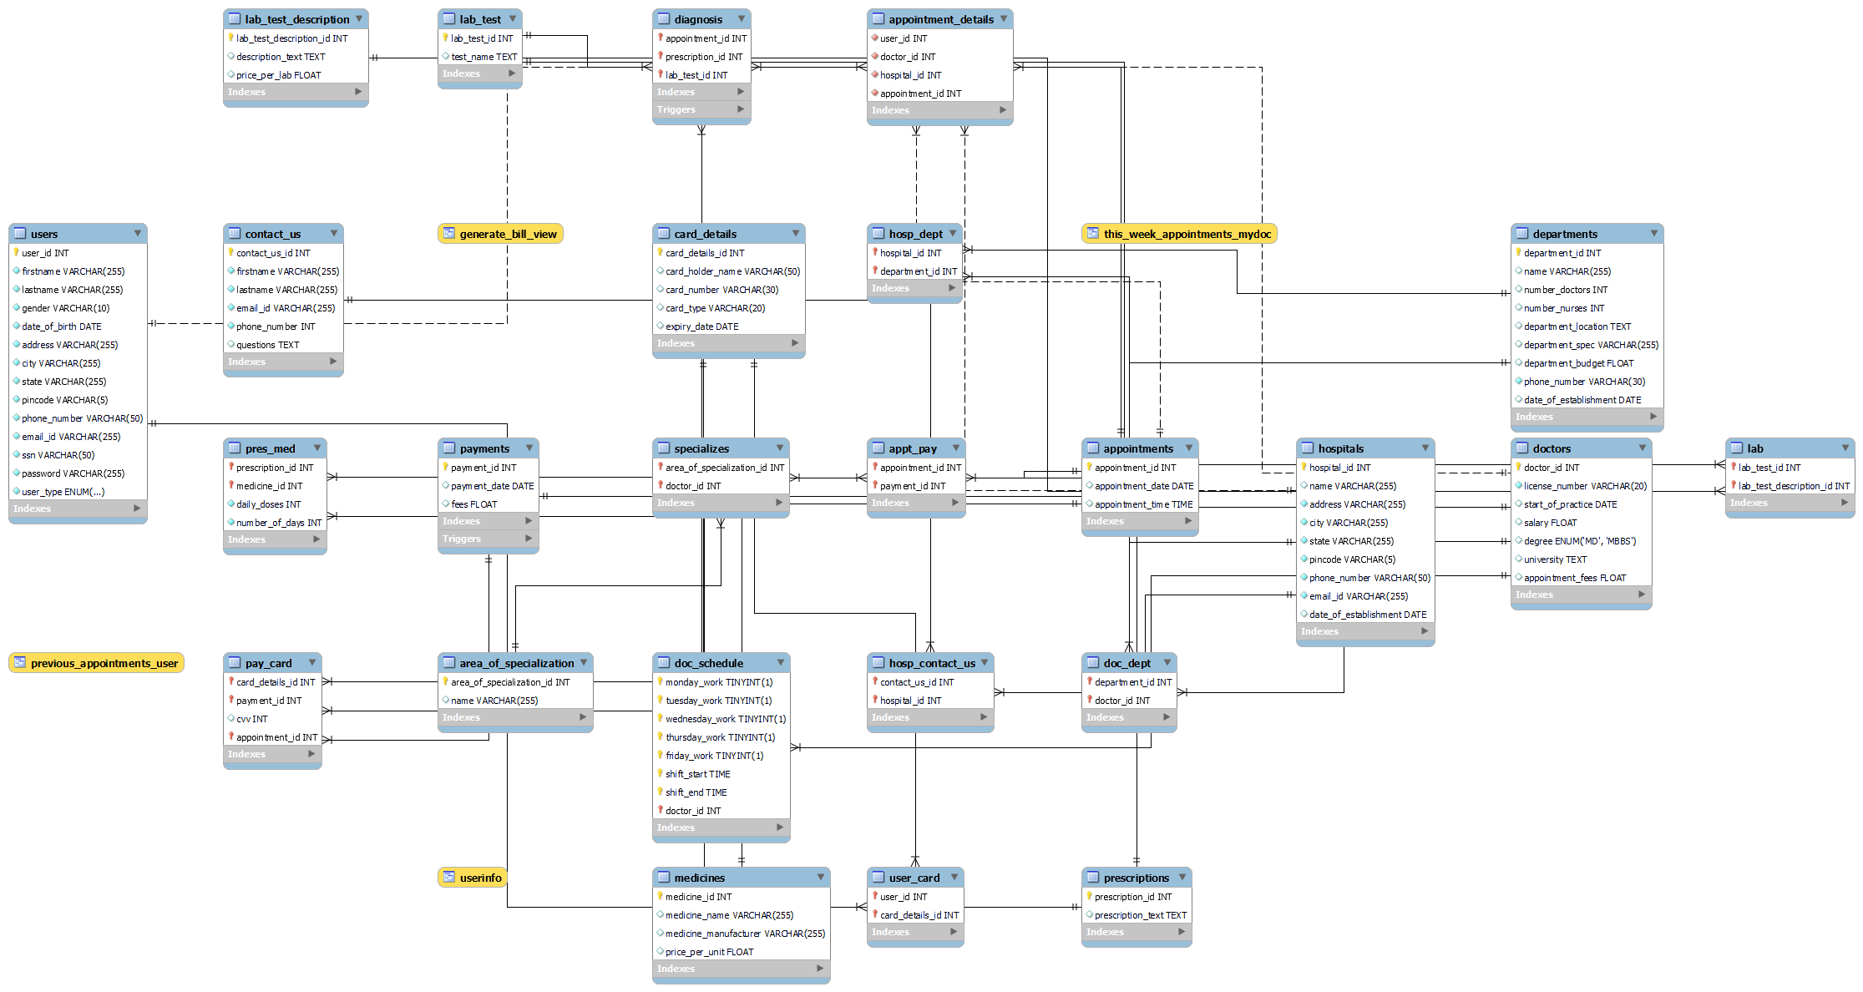
Relational Model

Slide 5
Stored Procedures
The onCall procedure checks the available doctors for that date & time which helps to book the appointment.
The numDoc procedure shows the number of doctors working on a given day by filtering the hospital and department.
The getthisWeek procedure helps to get the know on which date the week began and ended when the user enters a date.
To bookAppointment the user must enter the doctor, hospital, date & time. It checks whether an appointment has already been booked for that given date & time or not. This all helps us to book an appointment.

Slide 6
Functions
Calculates the total number of a specific medicine consumed that is the number of medicines multiplied by the daily dosage.
Now the prescription is made based on the number of medicines consumed multiplied by the cost of the specific medicine. This then adds to the final bill.
The same goes for lab tests. This is also added up in the final bill.
Then the visit fees are shown and then added to the final bill.
The final bill is generated based on the above functions.

Slide 7
Views
Shows the previous appointments of the patient to the doctor on which the doctor performs the diagnosis.
The doctor can see their current and updated schedule.
The Final bill generated can be seen by the user.
The admin can view the details of all the users including the doctors excluding sensitive information such as the Social Security Number and password of each user.
While paying the bill the user can view their saved cards.

Slide 8
Triggers
When the diagnosis table is updated in which the doctor decided to give the patient prescribed medication or perform lab tests. The final bill will also be updated.
A trigger is created to update the final bill of the user when it exceeds by $500. The trigger gives a discount of 10% off the bill.

Slide 9
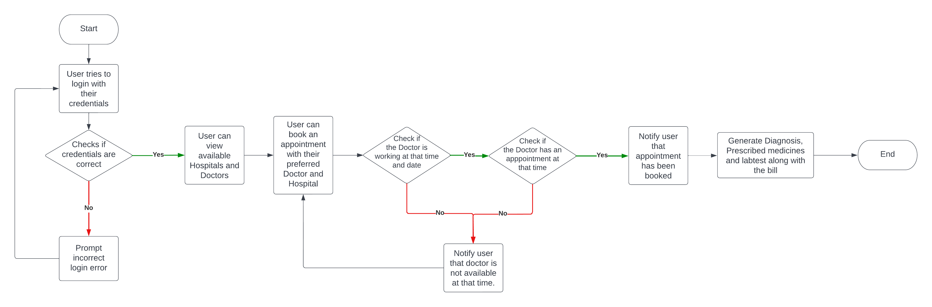
Flow Chart

Slide 10
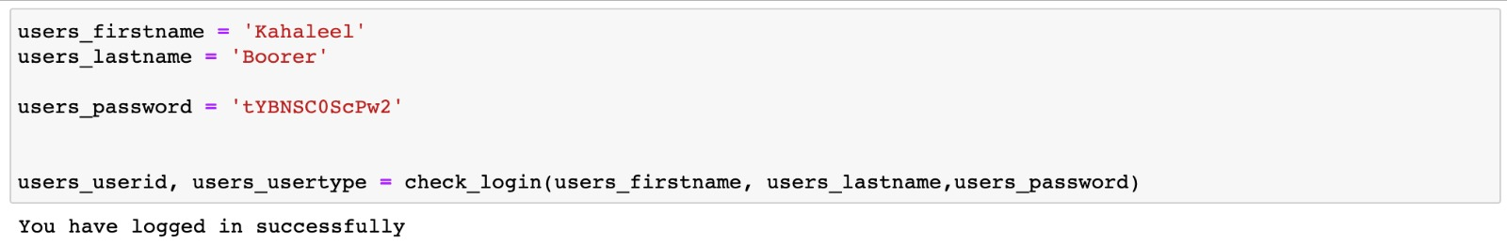
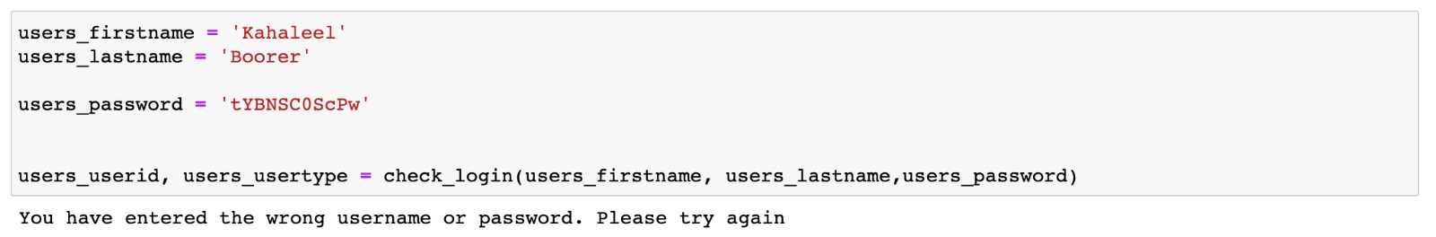
Ensure Correct Login

Slide 11
Appointment Booking
For any user to book an appointment first we have to check whether the doctor is working on that date and time.
Then we are checking if they have an appointment in that given time frame.
If the slot is empty, we are booking the appointment and sending out a confirmation message.
We are achieving this using stored procedure and showing the output status message in a session variable. It utilizes CRUD operations.

Slide 12
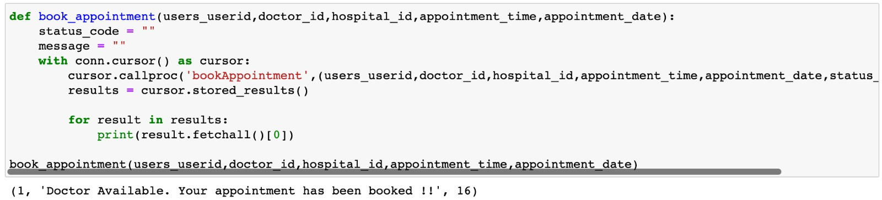
Successful Appointment Booking

Slide 13
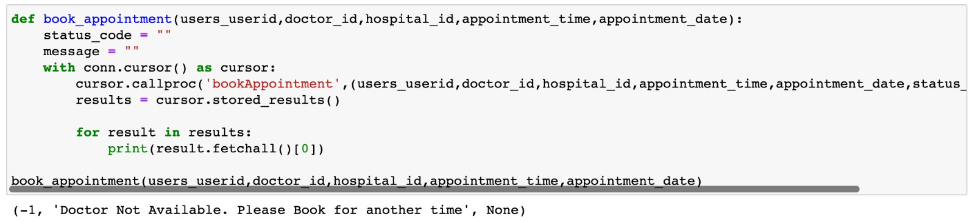
Unsuccessful Appointment Booking

Slide 14
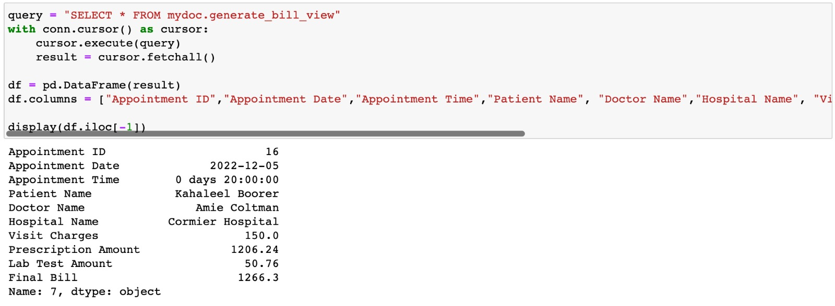
Generate Bill

Slide 15
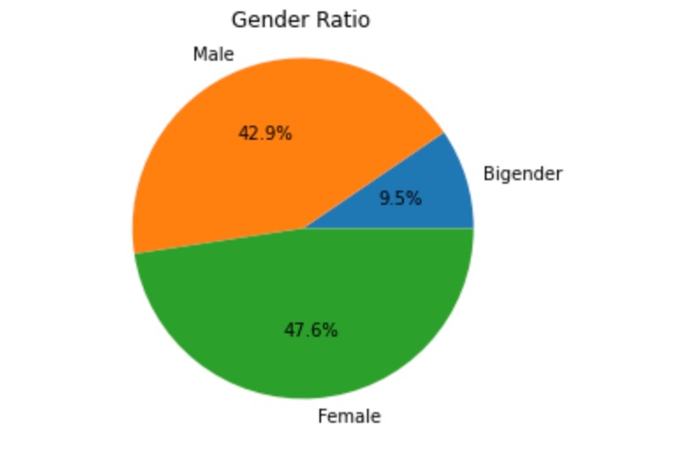
Exploratory Data Analysis
The pie chart depicts the classification of the user type by gender.

Slide 16
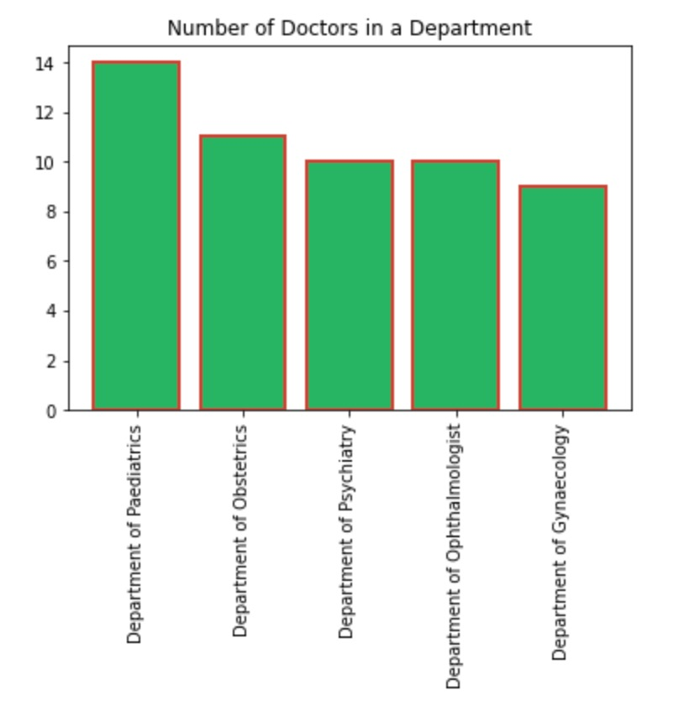
Exploratory Data Analysis
The bar chart plots the number of doctors in each department.

Slide 17
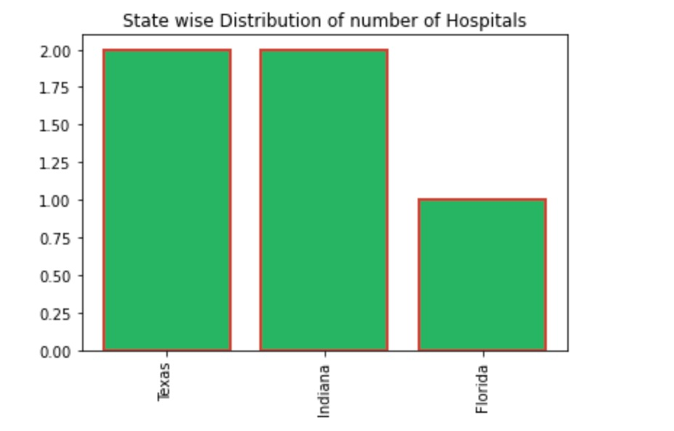
Exploratory Data Analysis
This shows the state-wise distribution of the number of hospitals in a state which helps the user to look up hospitals in their state.

Slide 18
Future Scope
The application can be further modified by the introduction of the insurance claim. If the patient has medical insurance, they can utilize it which covers a certain part of their bill.
Reviews of each doctor can be added. Before booking an appointment, the user can see the reviews posted of the doctors by previous users.
Further access can be given to doctors where they can make changes to their appointments.

Slide 19
Thank you

